Slide 1
Design Patterns
Singleton Pattern
IT 426

Slide 2

Definition
Gang of four
“Ensure a class only has one instance, and provide a global point of access to it.”

Slide 3
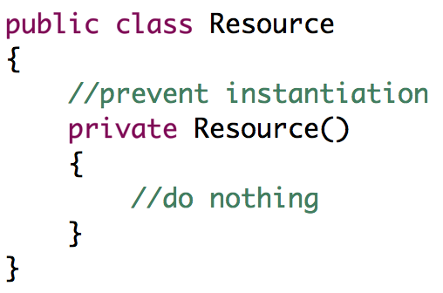
Singleton Pattern
How do we prevent (control) instantiation of objects?
Not write a constructor?
Change our access modifier to private!

Slide 4
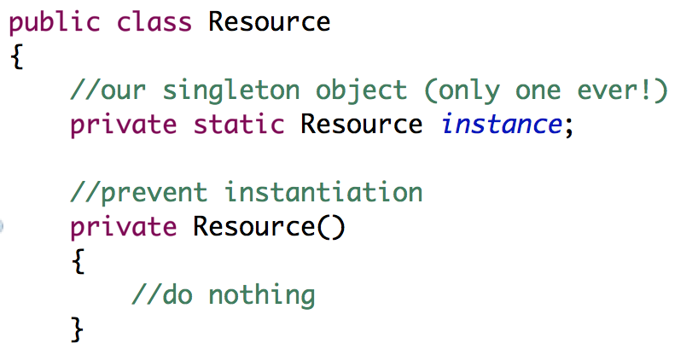
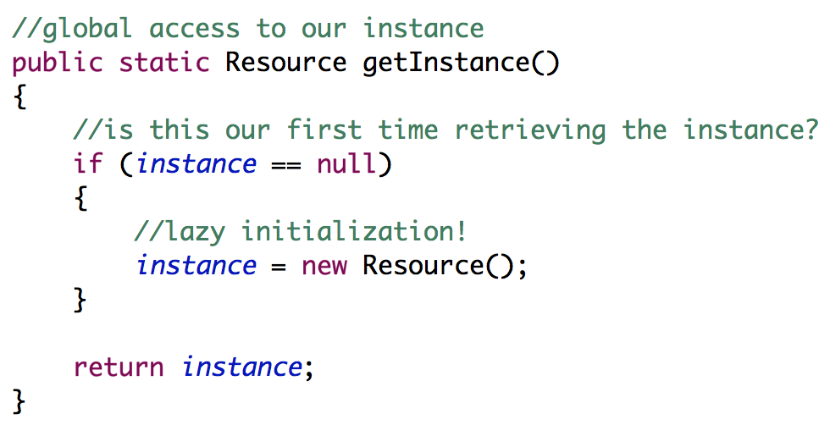
Singleton Pattern
Provide a global point of access to the object
Store the object in a static field
Create a static getter for the field

Slide 5

Lazy Initialization Pattern
Notice how we don’t instantiate our object until we need it
This is useful when:
An object requires significant memory or processing power
An object requires important system resources
Database connections, file handles, etc…
Several objects are created at the start of your application

Slide 6
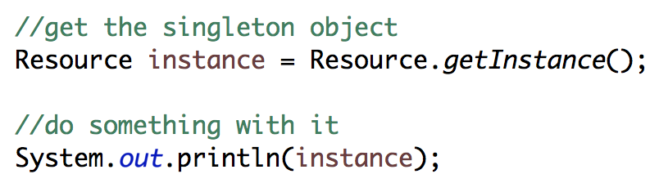
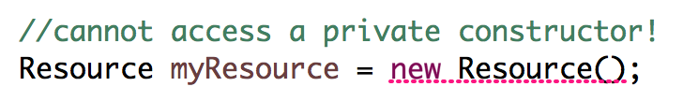
Retrieving our singleton
Retrieving our singleton
We can’t instantiate the class

Slide 7

Variations
The Multiton Pattern
Provides access to several singleton objects
Each singleton is accessible by name (how?)
Singletons are created when requested for the first time (lazy init…)
Double Checked Locking Pattern
Provides a thread safe implementation of the Singleton Pattern

Slide 8

The Singleton Pattern
Creational Pattern
Participants
Singleton: “Defines an instance operations that lets clients access its unique instance”

Slide 9
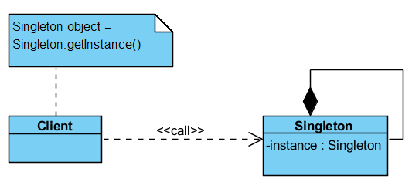
Let’s write some code

Slide 10
Sources
Gamma, Erich, et al. Design Patterns: Elements of Reusable Object-Oriented Software. Indianapolis, IN: Addison-Wesley, 1994

Slide 11
Design Patterns
Singleton Pattern
IT 426

